Slide 1
WHEEL OF WINNING WHEEL OF WINNING WHEEL OF WINNING WHEEL OF WINNING WHEEL OF WINNING WHEEL OF WINNING WHEEL OF WINNING WHEEL OF WINNING WHEEL OF WINNING WHEEL OF WINNING WHEEL OF WINNING WHEEL OF WINNING
WHEEL OF WINNING WHEEL OF WINNING WHEEL OF WINNING WHEEL OF WINNING WHEEL OF WINNING WHEEL OF WINNING WHEEL OF WINNING WHEEL OF WINNING WHEEL OF WINNING WHEEL OF WINNING WHEEL OF WINNING WHEEL OF WINNING
PLAY GAME
Notes:
Wheel of WINNING Powerpoint Template - Introduction Slide
Designed by Reid Powell at YouthDownloads.com

Slide 2
TOSS UP ROUND
BEGIN
NEXT
ROUND
E
M
P
I
R
E
S
T
A
T
E
B
U
I
L
D
I
N
G
CATEGORY: PLACE
CORRECT
Win
Bankrupt
Cheer
Boo
Silence
Notes:
*This is a SAMPLE Toss Up Slide* After you place your letters, and delete the unused boxes, it should look and animate like this slide.

Slide 3
TOSS UP ROUND
BEGIN
GO TO
ROUND 1
-
-
-
-
-
-
-
-
-
-
-
-
-
-
-
-
-
-
-
-
-
-
-
-
-
-
-
-
-
-
-
-
-
-
-
-
-
-
-
-
-
-
-
-
-
-
-
-
-
-
-
-
CATEGORY: PLACE
CORRECT
Win
Bankrupt
Cheer
Boo
Silence
Notes:
Toss Up Slide (to see who goes first)
How to edit this slide: Type in your letters (in all caps) in the boxes where you want them, and then DELETE the boxes with the [-] you won’t be using. You need to delete all the layers until you see the green board underneath. Then type in your category.
How to use this slide in gameplay:
This is a “Toss Up” slide. It is used to decide which player goes first. The person who correctly guesses first wins $250 and gets to go first. Players can only guess once.
To start the animation, simply click “begin” up top (or hit the space bar) and click “correct” at the bottom when someone guesses correctly.
WARNING. Do NOT click anywhere on the screen while the letters are appearing (except on a button). If you click anywhere else, all the letters will reveal at once.

Slide 4
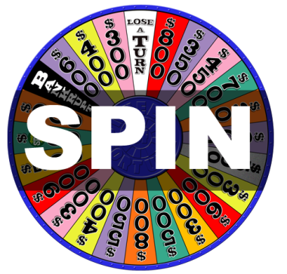
Round 1
NEXT
ROUND
F
O
R
G
E
T
A
B
O
U
T
I
T
CATEGORY: PHRASE
INCORRECT
Win
Bankrupt
Cheer
Boo
Silence
Notes:
*This is a SAMPLE Main Game Board Slide* After you place your letters, and delete the unused boxes, it should look and animate like this slide.

Slide 5
Round 1
NEXT
ROUND
-
-
-
-
-
-
-
-
-
-
-
-
-
-
-
-
-
-
-
-
-
-
-
-
-
-
-
-
-
-
-
-
-
-
-
-
-
-
-
-
-
-
-
-
-
-
-
-
-
-
-
-
CATEGORY: PHRASE
INCORRECT
Win
Bankrupt
Cheer
Boo
Silence
Notes:
Main Game Board
To edit this slide: Type in your letters (in all caps) in the boxes where you want them, and then DELETE the boxes with the [-] you won’t be using. You need to delete all the layers until you see the green board underneath. Then type in your category.
How to use this slide during gameplay:
This is the main board for this round. After looking at the board and receiving the category, the first player spins the wheel, and then guesses a letter. The player receives the amount of money shown on the wheel for every correct letter they can guess. They keep guessing until they miss a letter. Then it is the next person’s turn to spin, and guess. In the show, players can only guess vowels by “buying a vowel” guess. For every vowel a player guesses, $250 is deducted from their score.
How to operate this slide during gameplay:
You must REMEMBER where each letter is located on the board. When a player guesses a correct letter, click on all the places on the board where that letter is located. If the player guesses incorrectly, hit the “incorrect” icon, and move on to the next player. Have the next player spin then come back here and guess a letter.

Slide 6
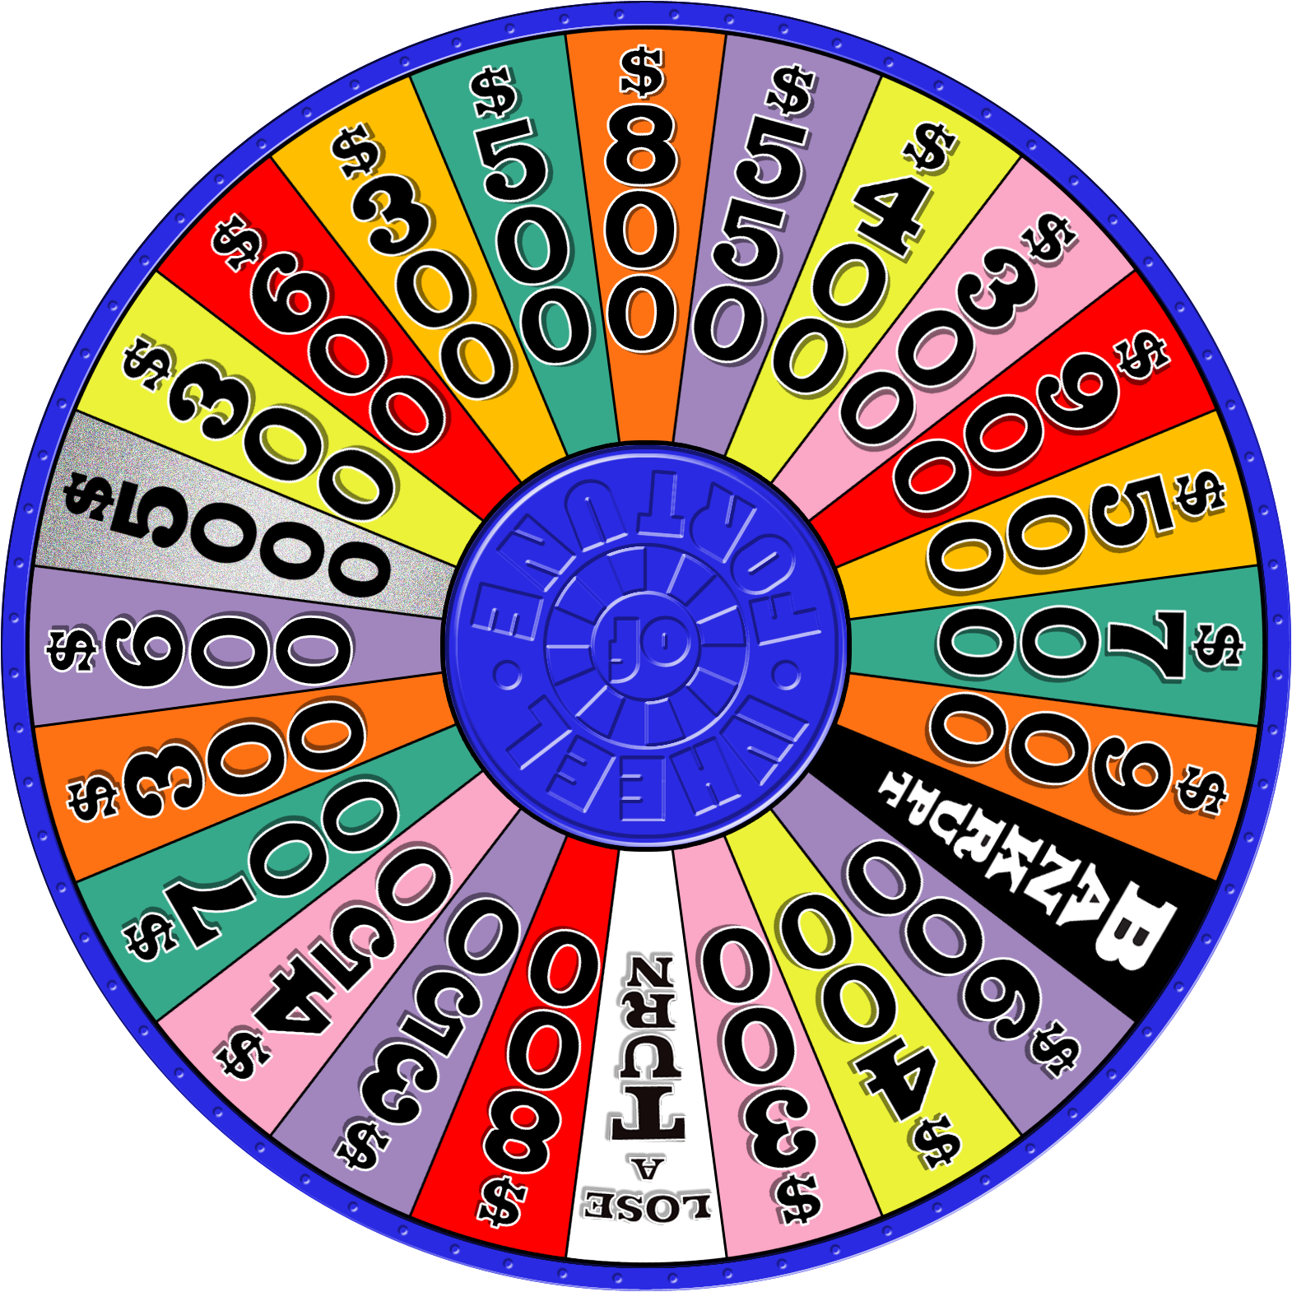
BACK TO
BOARD
SPIN
STOP
Win
Bankrupt
Cheer
Boo
Silence
Notes:
*DO NOT DELETE THIS SLIDE*. It is automatically transitioning slide that resets the animation for the wheel on the following slide.

Slide 7
BACK TO
BOARD
SPIN
STOP
Win
Bankrupt
Cheer
Boo
Silence
Notes:
*DO NOT DELETE THIS SLIDE*. It is automatically transitioning slide that resets the animation for the wheel on the following slide.

Slide 8
BACK TO
BOARD
SPIN
STOP
Win
Bankrupt
Cheer
Boo
Silence
Notes:
Wheel of WINNING Spinner
Click the SPIN button to spin the wheel. Click STOP to stop.

Slide 9
Round 2
NEXT
ROUND
-
-
-
-
-
-
-
-
-
-
-
-
-
-
-
-
-
-
-
-
-
-
-
-
-
-
-
-
-
-
-
-
-
-
-
-
-
-
-
-
-
-
-
-
-
-
-
-
-
-
-
-
CATEGORY: PHRASE
INCORRECT
Win
Bankrupt
Cheer
Boo
Silence
Notes:
Main Game Board
To edit this slide: Type in your letters (in all caps) in the boxes where you want them, and then DELETE the boxes with the [-] you won’t be using. You need to delete all the layers until you see the green board underneath. Then type in your category.
How to use this slide during gameplay:
This is the main board for this round. After looking at the board and receiving the category, the first player spins the wheel, and then guesses a letter. The player receives the amount of money shown on the wheel for every correct letter they can guess. They keep guessing until they miss a letter. Then it is the next person’s turn to spin, and guess. In the show, players can only guess vowels by “buying a vowel” guess. For every vowel a player guesses, $250 is deducted from their score.
How to operate this slide during gameplay:
You must REMEMBER where each letter is located on the board. When a player guesses a correct letter, click on all the places on the board where that letter is located. If the player guesses incorrectly, hit the “incorrect” icon, and move on to the next player. Have the next player spin then come back here and guess a letter.

Slide 10
BACK TO
BOARD
SPIN
STOP
Win
Bankrupt
Cheer
Boo
Silence
Notes:
*DO NOT DELETE THIS SLIDE*. It is automatically transitioning slide that resets the animation for the wheel on the following slide.

Slide 11
BACK TO
BOARD
SPIN
STOP
Win
Bankrupt
Cheer
Boo
Silence
Notes:
*DO NOT DELETE THIS SLIDE*. It is automatically transitioning slide that resets the animation for the wheel on the following slide.

Slide 12
BACK TO
BOARD
SPIN
STOP
Win
Bankrupt
Cheer
Boo
Silence
Notes:
Wheel of WINNING Spinner
Click the SPIN button to spin the wheel. Click STOP to stop.

Slide 13
Round 3
NEXT
ROUND
-
-
-
-
-
-
-
-
-
-
-
-
-
-
-
-
-
-
-
-
-
-
-
-
-
-
-
-
-
-
-
-
-
-
-
-
-
-
-
-
-
-
-
-
-
-
-
-
-
-
-
-
CATEGORY: PHRASE
INCORRECT
Win
Bankrupt
Cheer
Boo
Silence
Notes:
Main Game Board
To edit this slide: Type in your letters (in all caps) in the boxes where you want them, and then DELETE the boxes with the [-] you won’t be using. You need to delete all the layers until you see the green board underneath. Then type in your category.
How to use this slide during gameplay:
This is the main board for this round. After looking at the board and receiving the category, the first player spins the wheel, and then guesses a letter. The player receives the amount of money shown on the wheel for every correct letter they can guess. They keep guessing until they miss a letter. Then it is the next person’s turn to spin, and guess. In the show, players can only guess vowels by “buying a vowel” guess. For every vowel a player guesses, $250 is deducted from their score.
How to operate this slide during gameplay:
You must REMEMBER where each letter is located on the board. When a player guesses a correct letter, click on all the places on the board where that letter is located. If the player guesses incorrectly, hit the “incorrect” icon, and move on to the next player. Have the next player spin then come back here and guess a letter.

Slide 14
BACK TO
BOARD
SPIN
STOP
Win
Bankrupt
Cheer
Boo
Silence
Notes:
*DO NOT DELETE THIS SLIDE*. It is automatically transitioning slide that resets the animation for the wheel on the following slide.

Slide 15
BACK TO
BOARD
SPIN
STOP
Win
Bankrupt
Cheer
Boo
Silence
Notes:
*DO NOT DELETE THIS SLIDE*. It is automatically transitioning slide that resets the animation for the wheel on the following slide.

Slide 16
BACK TO
BOARD
SPIN
STOP
Win
Bankrupt
Cheer
Boo
Silence
Notes:
Wheel of WINNING Spinner
Click the SPIN button to spin the wheel. Click STOP to stop.

Slide 17
Final Round
-
-
-
-
-
-
-
-
-
-
-
-
-
-
-
-
-
-
-
-
-
-
-
-
-
-
-
-
-
-
-
-
-
-
-
-
-
-
-
-
-
-
-
-
-
-
-
-
-
-
-
-
CATEGORY: PHRASE
INCORRECT
Win
Bankrupt
Cheer
Boo
Silence
Notes:
Main Game Board
To edit this slide: Type in your letters (in all caps) in the boxes where you want them, and then DELETE the boxes with the [-] you won’t be using. You need to delete all the layers until you see the green board underneath. Then type in your category.
How to use this slide during gameplay:
This is the main board for this round. After looking at the board and receiving the category, the first player spins the wheel, and then guesses a letter. The player receives the amount of money shown on the wheel for every correct letter they can guess. They keep guessing until they miss a letter. Then it is the next person’s turn to spin, and guess. In the show, players can only guess vowels by “buying a vowel” guess. For every vowel a player guesses, $250 is deducted from their score.
How to operate this slide during gameplay:
You must REMEMBER where each letter is located on the board. When a player guesses a correct letter, click on all the places on the board where that letter is located. If the player guesses incorrectly, hit the “incorrect” icon, and move on to the next player. Have the next player spin then come back here and guess a letter.

Slide 18
BACK TO
BOARD
SPIN
STOP
Win
Bankrupt
Cheer
Boo
Silence
Notes:
*DO NOT DELETE THIS SLIDE*. It is automatically transitioning slide that resets the animation for the wheel on the following slide.

Slide 19
BACK TO
BOARD
SPIN
STOP
Win
Bankrupt
Cheer
Boo
Silence
Notes:
*DO NOT DELETE THIS SLIDE*. It is automatically transitioning slide that resets the animation for the wheel on the following slide.

Slide 20
BACK TO
BOARD
SPIN
STOP
Win
Bankrupt
Cheer
Boo
Silence
Notes:
Wheel of WINNING Spinner
Click the SPIN button to spin the wheel. Click STOP to stop.

Slide 21
Thanks for playing.
Notes:
Wheel of WINNING Spinner
Click the SPIN button to spin the wheel. Click STOP to stop.

